Slide 1
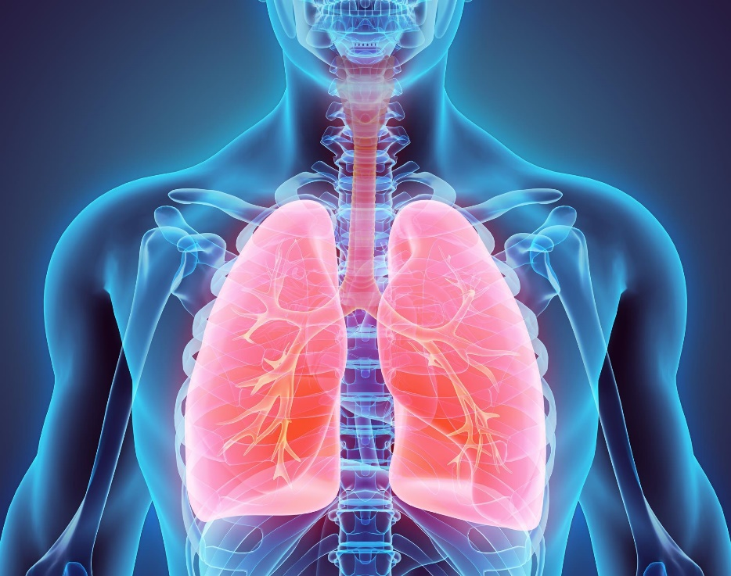
Respiratory diseases in the elderly
Professor of the Department internal diseases Liskova Yu.V.

Slide 2
Globally, life expectancy is projected to increase from 68 years in 2015–2020 to 81 years in 2095–2100 according to the 2010 Revision of World Population Prospects, the official United Nation Population Projects.
This is 35 years longer than that at beginning of the 20th century (46 years).
Therefore, an increase in incidence of age-associated diseases such as Alzheimer’s disease, cataract, rheumatoid arthritis, osteoporosis and cardiovascular disease will have a profound public health impact.
Aging is a complex, universal condition leading to the functional decline of all cells and organisms, and to major global public health problems

Slide 4
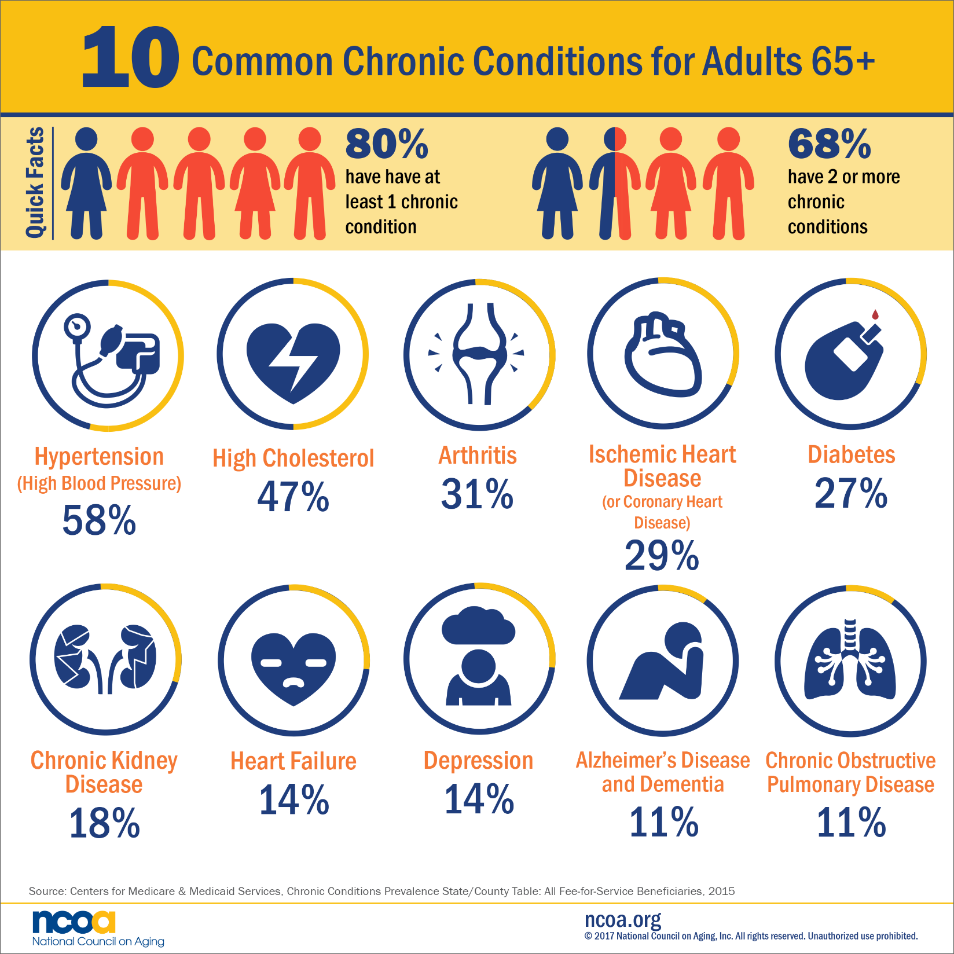

Slide 5
Difficulties in Recognizing Respiratory Symptoms
A common misperception is that older people tend to overestimate or exaggerale respiratory
symptoms the opposite is more often true .
Older people often have more than one explanation
for their problems:
- Dyspnea, cough, and wheezing may overlap
- The causes may include a combination of
diseases such as asthma or emphysema,
obstructive sleep apnea, heart failure, and GERD

Slide 6
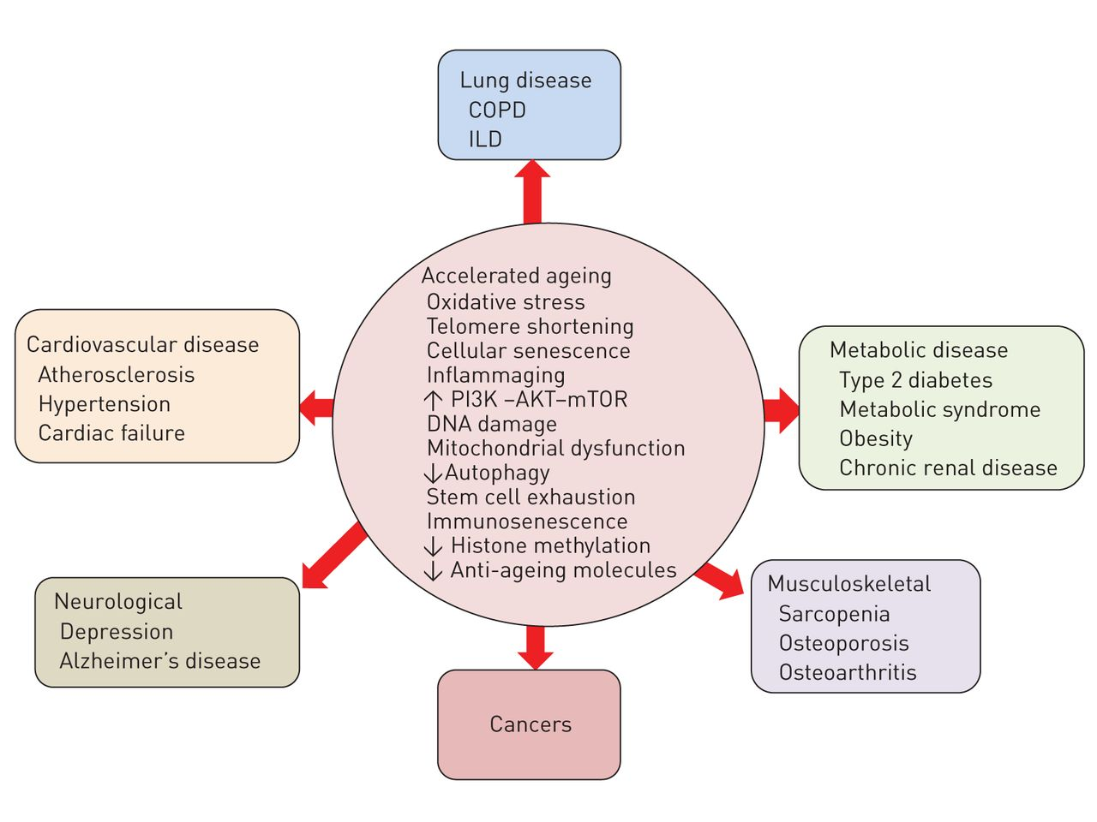
Mechanisms of development of multimorbidity

Slide 7
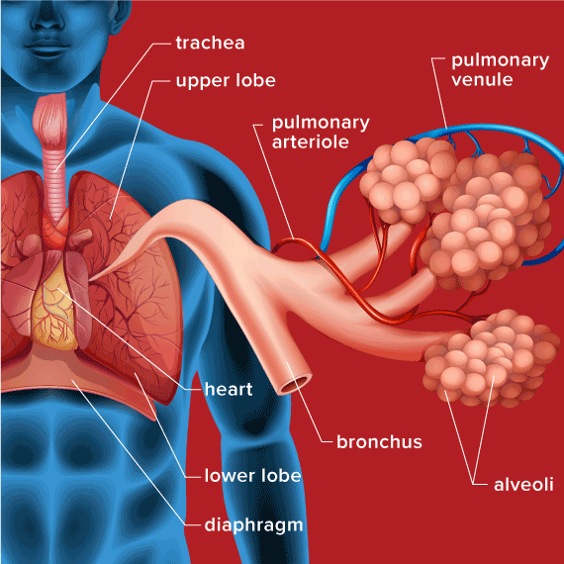

Slide 8
Aging is a complex, heterogeneous, and multifactorial phenomenon, which is the consequence of multiple interactions between genes and environment.
Senescence or aging is defined as the progressive decline of homeostasis that occurs after the reproductive phase of life is complete, leading to an increasing risk of disease or death.
Underlying the aging process is a lifelong, bottom-up accumulation of molecular damage. Kirkwood also hypothesized that inflammatory and anti-inflammatory factors can play a part in shaping the outcomes of the aging process because cellular defects often cause inflammatory reactions, which can themselves exacerbate existing damage.
Thus, aging is also considered as an inflammatory event. At molecular level, aging is the results of failure of reactive oxygen species (ROS) elimination, failure of repair of damaged DNA and telomere shortening.

Slide 9
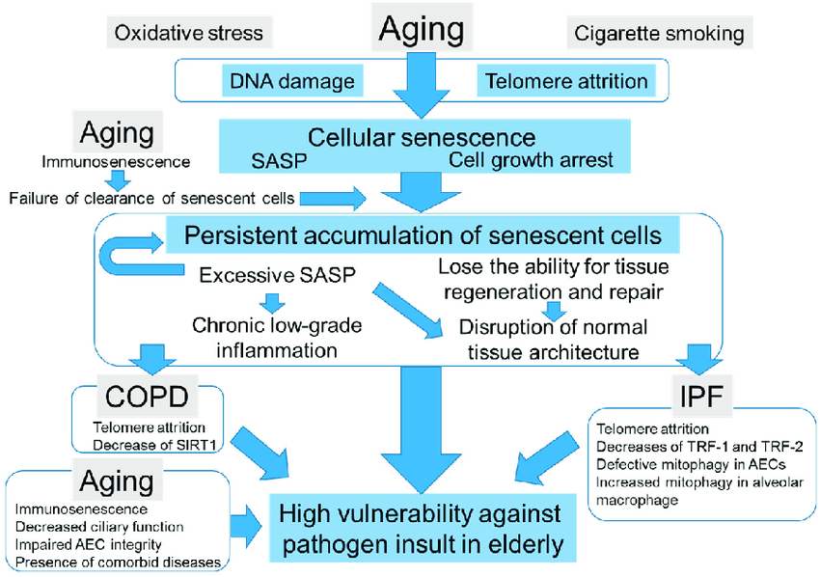

Slide 10
Chronic obstructive pulmonary disease (COPD) is one of the well-known age-associated diseases and a major and increasing global health problem with enormous amount of expenditure of indirect/direct health care costs.
There is still a fundamental lack of knowledge about the cellular, molecular and genetic causes of COPD.
Therefore, current therapies are inadequate and no treatments reduce disease progression or mortality. Thus, the incidence of COPD increases with age, suggesting an intimate relationship between the pathogenesis of COPD and aging

Slide 11
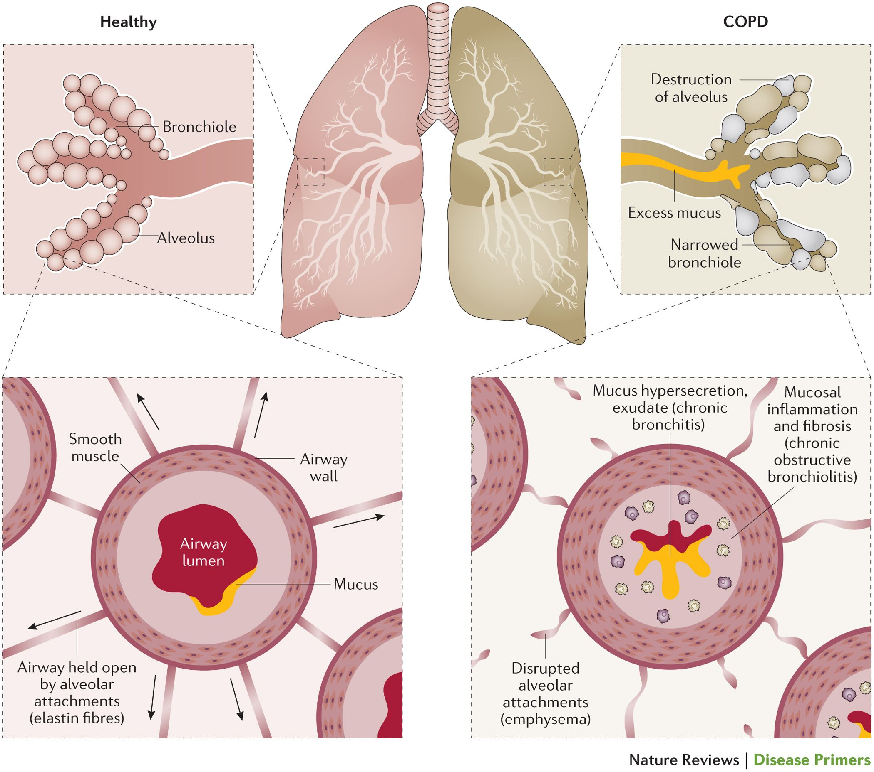

Slide 12
COPD as an accelerating aging disease
As the prevalence is reported to be two to three times higher in the elderly (persons over 60 years of age), therefore, COPD is known as an aging associated disease.
The evidence for the role of accelerated aging in COPD progression is growing and senescence is one of possible molecular pathways for development of COPD

Slide 15
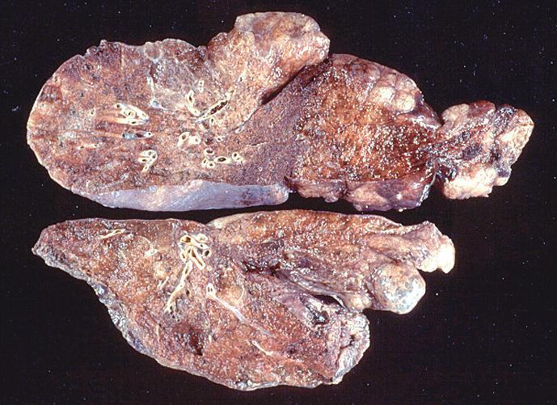
Gross pathology of advanced emphysema. Large bullae are present on the surface of the lung

Slide 16
Histopathology of chronic bronchitis showing hyperplasia of mucous glands and infiltration of the airway wall with inflammatory cells

Slide 18
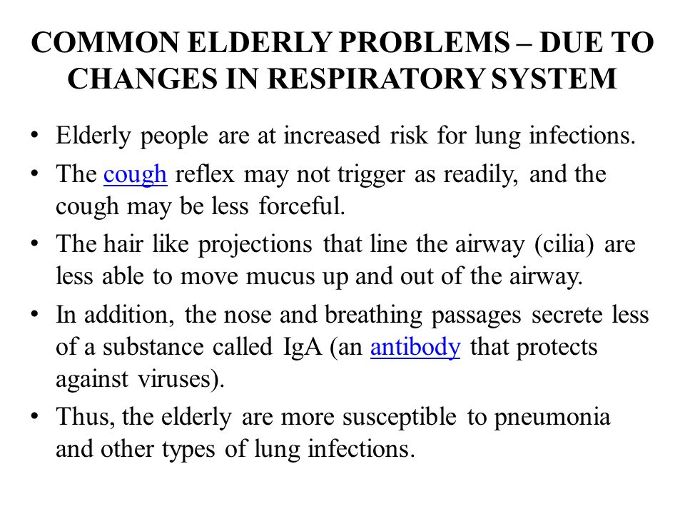

Slide 20
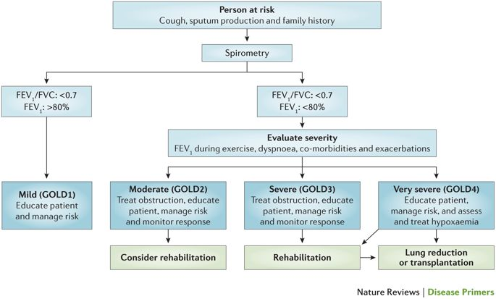

Slide 22
Main conditions potentially affecting the quality of spirometry and, consequently, the achievement of a state of art COPD diagnosis in the elderly
Motor and sensory deficits, e.g. pyramidal or e tra-pyramidal disorders
– Lack of de terity and poor control of ventilation during spirometry;
– Difficulty in coordination and properly sequencing the flow volume maneuver
and the breath holding.
Dementia or cognitive impairment: deteriorated constructive functions, verbal
attainment and, mainly, secondary verbal memory
– Difficulty in learning and recall instruction to perform spirometry
– Poor ability to interact with the technician or physician
Mood depression and psychological factors
– Poor motivation, early discouragement for unsuccessful trials.
Educational level
– Ability to understand technical instructions
Malnutrition/undernutrition, deconditioning: respiratory muscles weakness
– Difficulty in providing acceptable and reproducible tests

Slide 23
Diagnostic accuracy of volatile organic compounds fingerprint in the diagnosis of respiratory diseases.
Lung cancer | Results widely depend on the different sensor system used. Quartz microbalances currently show the best diagnostic accuracy around 90%. Sensitivity and specificity range from 70 to 90%
Asthma | The sensor system was able to separate mild asthmatics from controls, and moderate to severe asthmatics from controls, but not mild and moderate from severe asthmatic groups
COPD | Breath fingerprint was highly sensitive and specific in discriminating COPD patients from controls, hypo emic from non-hypo emic COPD and COPD from asthma
Interstitial lung disease | Interstitial lung disease E haled ethane seems a valuable indicator of disease activity and prognosis for ILDs.
Tuberculosis and other lung infections | The systemwas 89% sensitive and 91% specific at identifying M. tuberculosis. It was also able to differentiate several in-vitro gram + and gram− bacteria. E-nose fingerprints correctly classified 77% of the BAL samples,with and without microbiological growth, from ventilated patients not on antibiotics. Inclusion of patients on antibiotics resulted in 68% correct classification. Seventy percent of isolates were accurately discriminated into four clinically significant groups.

Slide 24
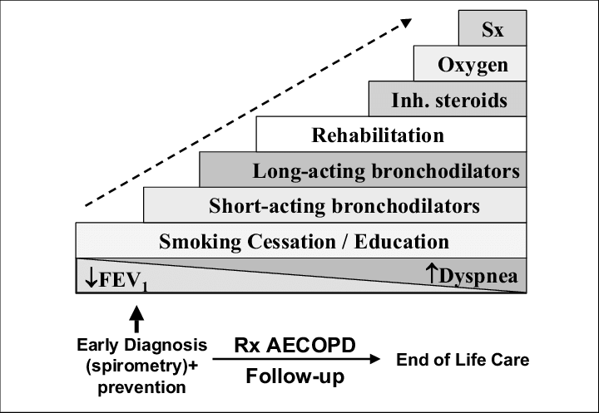

Slide 25
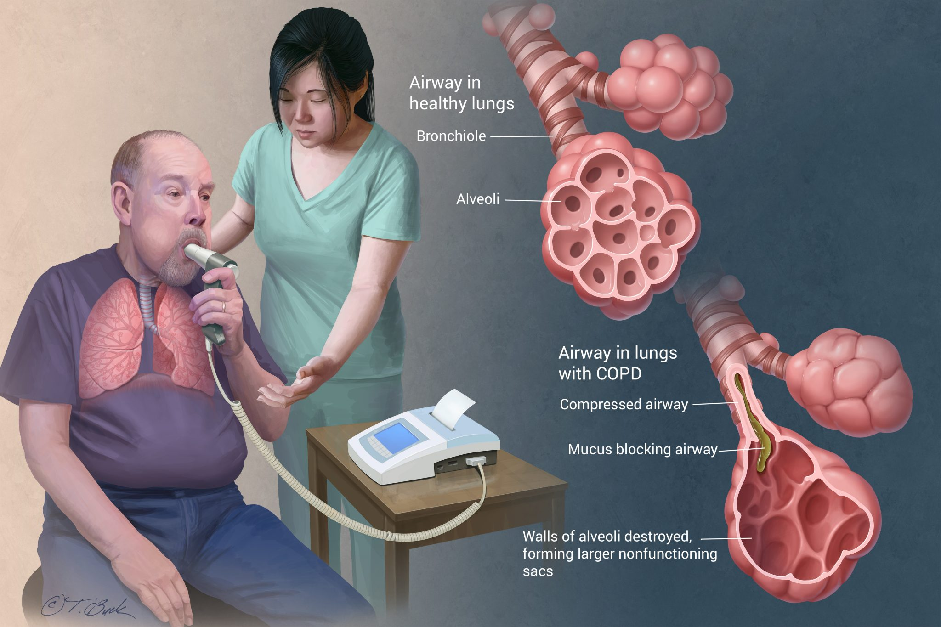

Slide 26
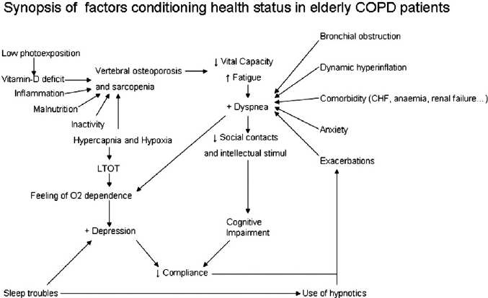

Slide 27
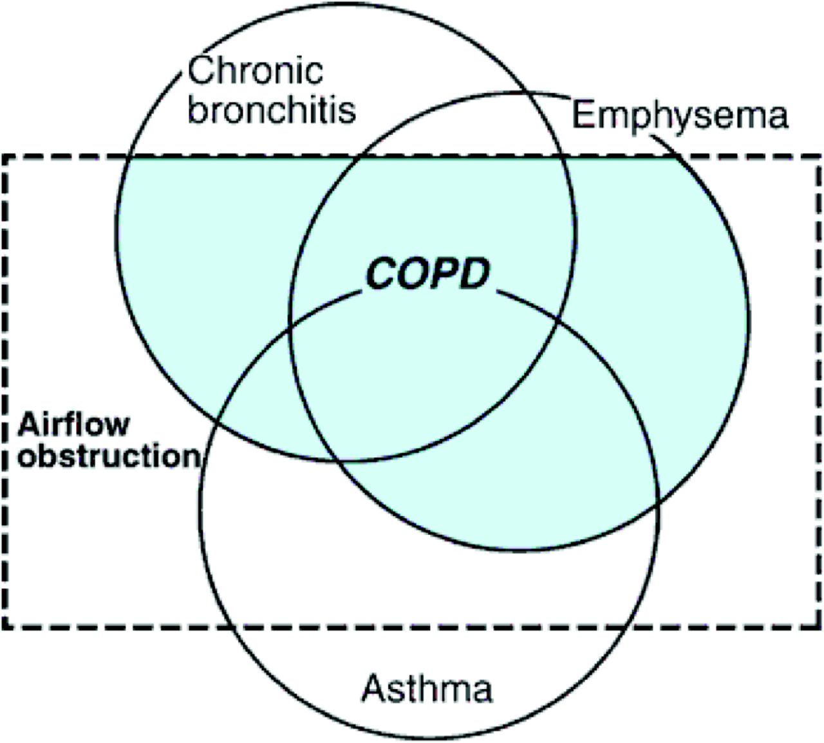

Slide 28
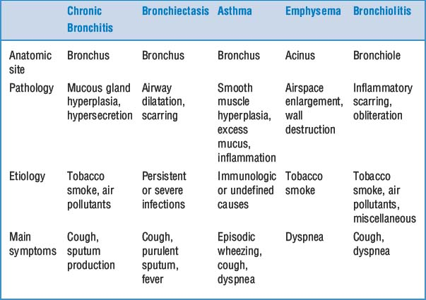

Slide 30
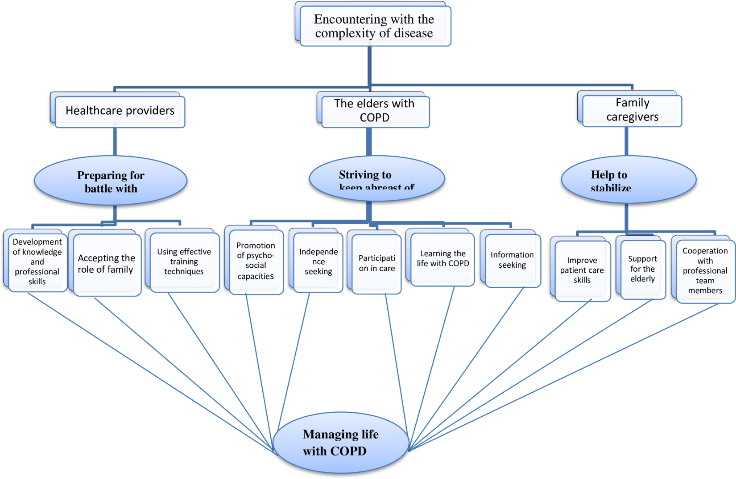
Notes:
Preparing for battle with disease consisted of three sub-categories, namely, “using effective training techniques,” “accepting the role of the elder family member in treatment,” and “development of knowledge and professional skills”.

Slide 31
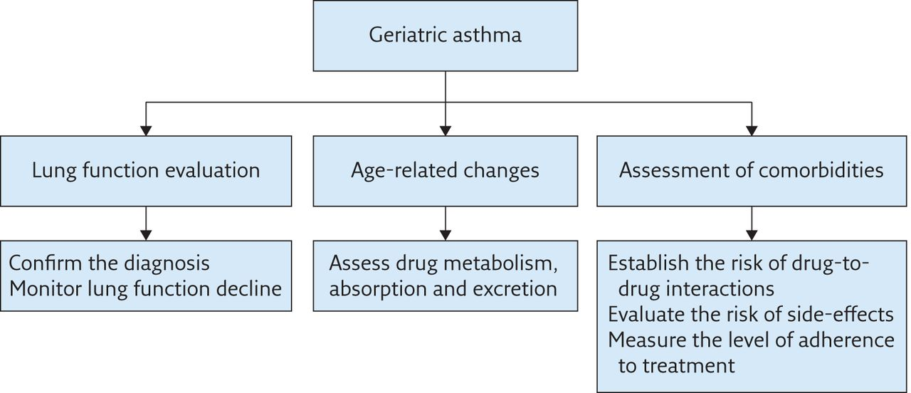

Slide 34
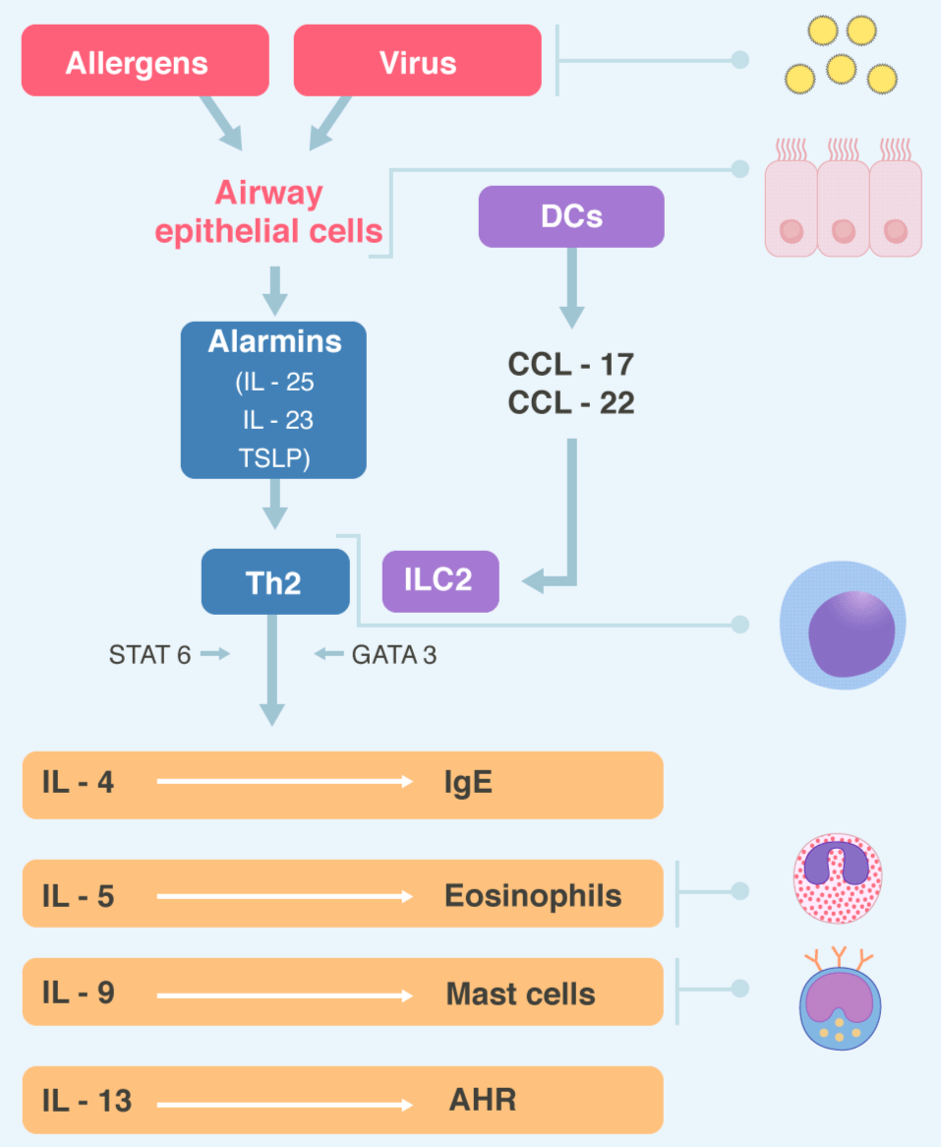
Notes:
Type 2 immunity Virus and inhaled allergens activated lung dendritic cells (DCs) to release the CC-chemokines ligand 17 (CCL17) and CCL22 which recruit T helper 2 (Th2) cells and group innate lymphoid cells (ILC2s). Activation of the transcription factor GATA3 and STAT6 in Th2 cells and ILC2s leads to secret of the cytokines IL-4, IL-5, IL-9, IL-13. These cytokines regulated IgE synthesis, eosinophilic proliferation, mast cells proliferation, and airway hyperreactivity (AHR) respectively. Epithelial cells also producing alarmins, including thymic stromal lymphopoietin (TSLP), Il-25 and IL-33, which are “upstream” cytokines in the eosinophilic response. STAT= Signal transduction and activator of transcription .

Slide 35
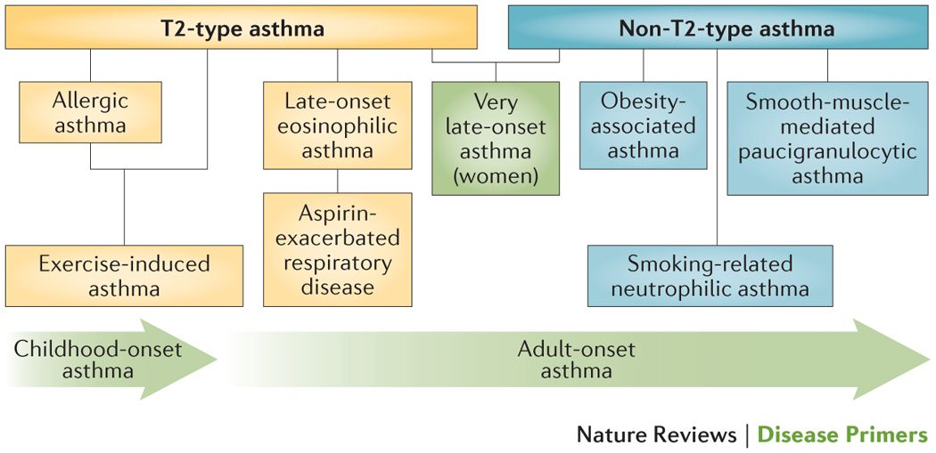

Slide 36
A proposed diagnostic algorithm for asthma in the elderly
History | Respiratory function tests | Supportive elements
H1. Recurrent wheeze | R1. Positive methacholine test | S1. Early onset (in adolescence or young adulthood
H2. Nocturnal wheeze | R2. Completely reversible bronchial obstruction | S2. History of atopy
H3. Dry cough (variant clinical presentation) | R3. Partially reversible bronchial obstruction | S3. Triggers identified
 |  | S4. Sputum eosinophilia S5. Steroid dependence S6. Normal DLCO

Slide 37
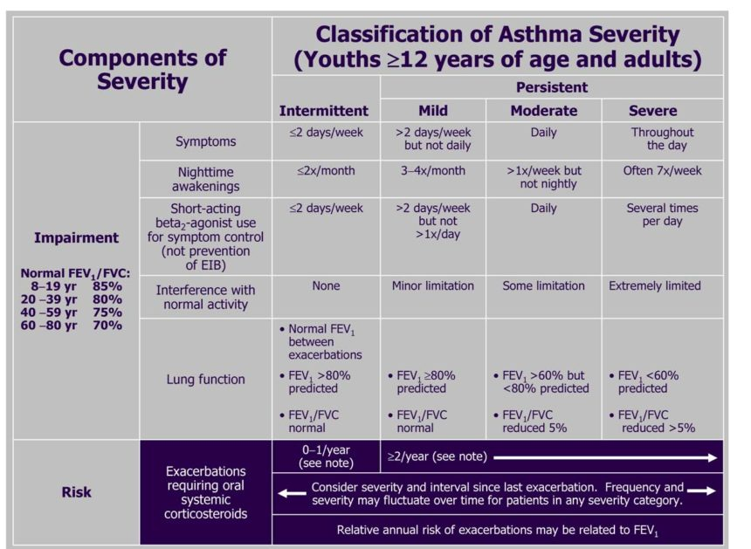

Slide 38
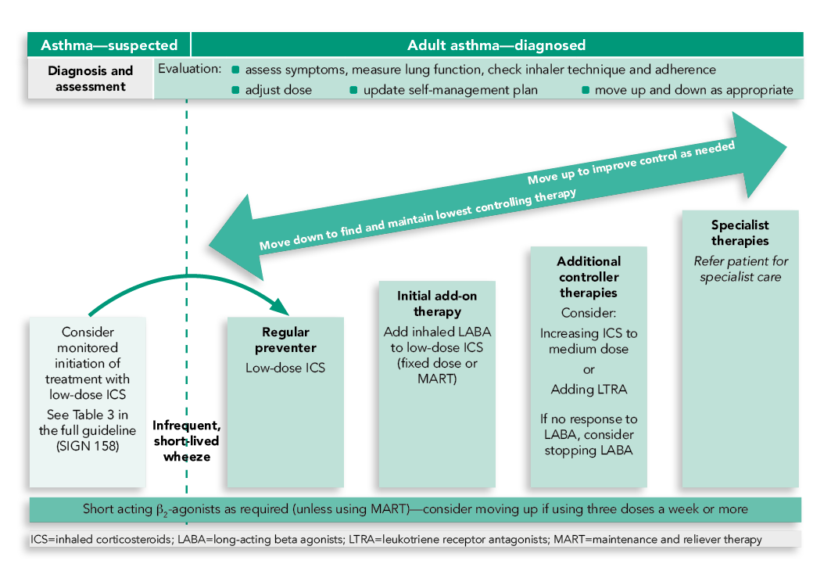

Slide 39
Treatment of asthma in the elderly
Beta-agonist therapy can cause tremor, a dose dependent reduction in serum potassium and tachycardia. Tremor is a common concern in the elderly asthmatic and it is caused by β2 stimulation of skeletal muscle. To minimise systemic absorption though oropharyngeal deposition a spacer device is recommended.
Theophylline must be used carefully in the elderly population and is associated with a number of adverse effects particularly when drug levels are above the therapeutic range. Drug toxicity is most likely in those with established cardiac or liver disease and there are a number of described drug interactions eg. quinolones and allopurinol. Careful monitoring of drug levels is required to reduce the risk of very serious adverse events such as cardiac arrhythmias and seizures.
Inhaled steroids at moderate doses are generally not associated with systemic side effects in the elderly population. However, local side effects are not uncommon and include oral candidiasis and hoarseness of the voice. These effects are dose-dependent and can usually be managed with the addition of a spacer device.

Slide 40
Treatment of asthma in the elderly
Systemic corticosteroids can cause or exacerbate significant systemic adverse effects in the elderly population including diabetes, cataracts, hypertension, osteoporosis and vertebral fractures. Systemic maintenance corticosteroids are however indicated for severe, uncontrolled asthma indicated at the higher steps of the GINA treatment recommendations.
Cholinergic receptors appear to function independently of ageing. As a consequence, there is a reduction in response to β-agonist bronchodilator therapy associated with ageing which has not been seen with anti-cholinergics. Indeed, some elderly patients respond better to anti-cholinergics than to beta agonists.
Elderly patients with severe allergic asthma should also be considered for omalizumab therapy. The GINA guidelines recommend this medication as "Step 4" add-on treatment. A subgroup analysis demonstrated that elderly patients also gain benefit from this medication

Slide 41
Asthma-COPD overlap syndrome (ACOS)
First of all, it should be clear that it is not a single entity, but that, like asthma and COPD, it includes several different forms of disease (phenotypes) caused by different underlying mechanisms.
The evidence of treatment is very limited due to the absence of pharmacotherapy studies in this population.
The term is coined basically for two reasons: the difficulty of distinguishing asthma from COPD, particularly in older adults and smokers, especially for the primary care physician where these patients initially consulted, and due to the fact that it is clear that patients who have concomitant asthma and COPD changes have more frequent exacerbations, poor quality of life, a more rapid decline in lung function and higher mortality, in addition to consuming greater health resources than asthma and COPD alone.
The wide range in the prevalence of the epidemiological reports of ACO (15-55%) exposes the different criteria for diagnosis, and this is due to the absence of a clear definition.

Slide 42
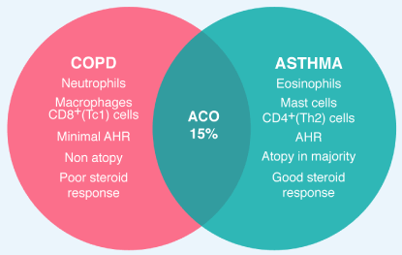
Notes:
BA, COPD, and ACO BA and COPD have distinct features, with different cells, mediators and consequences of inflammation as well as different response to treatment with corticosteroids. Approximately 15% of patients have features of BA and COPD (ACO)

Slide 43
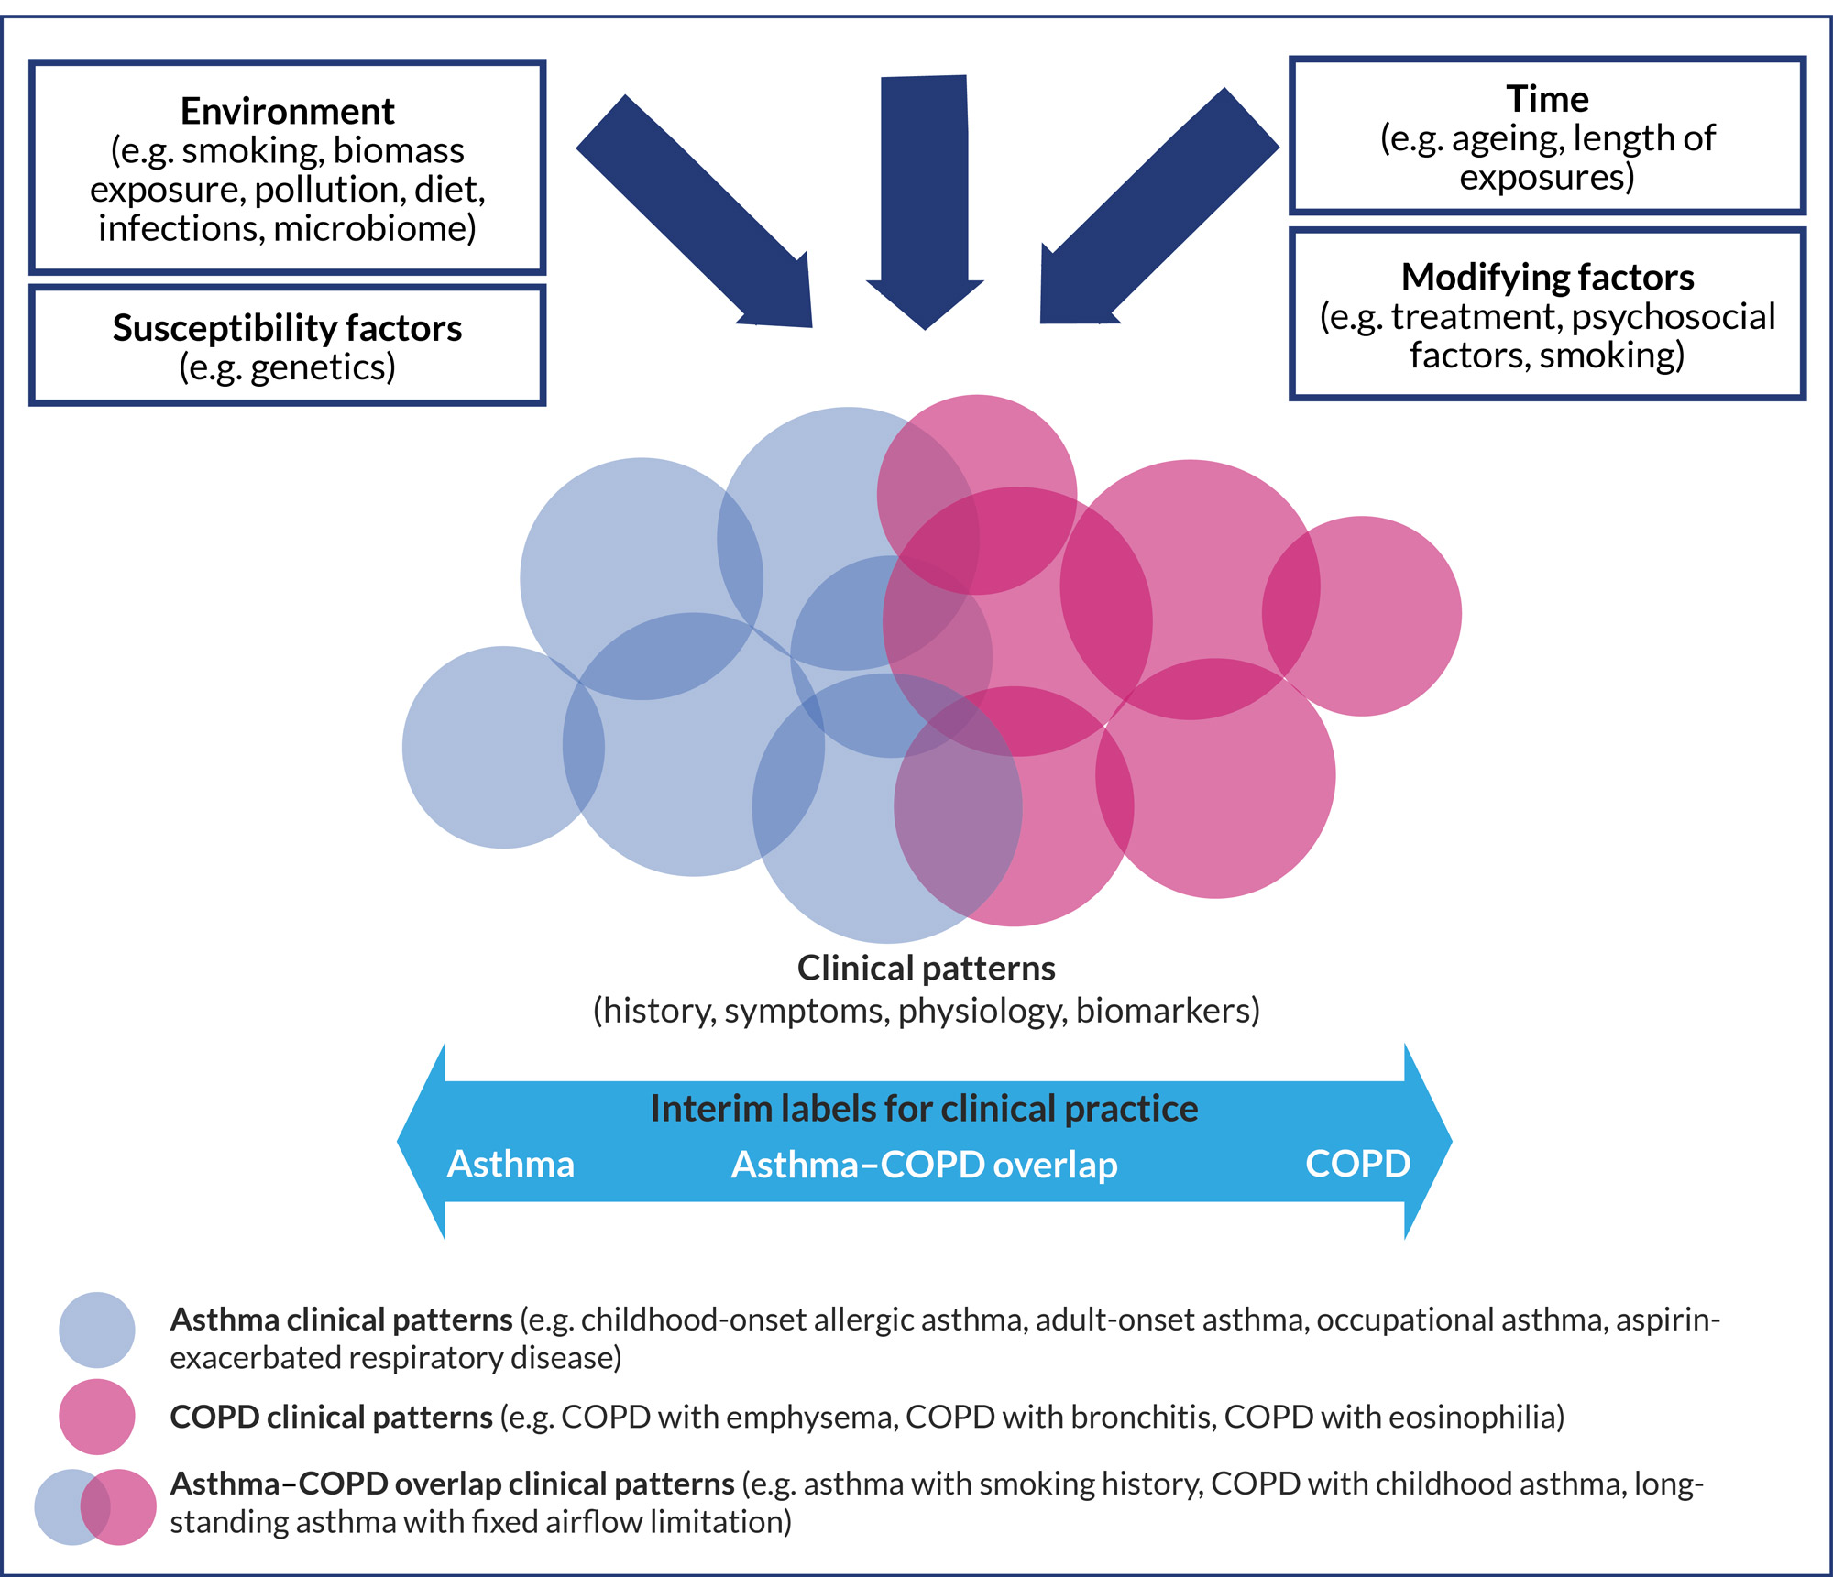

Slide 44
Asthma-COPD overlap syndrome (ACOS)
Unlike asthma and COPD, ACO does not have a definition but a description: "persistent airflow obstruction with several features usually associated with asthma and several features usually associated with COPD."
The patient must have a persistent airflow limitation. In addition to documenting the persistence of the obstruction, the diagnosis involves making a very good clinical history based on which 80% of the diagnosis of asthma, COPD or ACO rests. It is vital to take into account especially the findings that easily distinguish COPD asthma in clinical practice.
If several changes (three or more) strongly suggest COPD or if several changes (three or more) suggest asthma, in the absence of an alternative diagnosis; the diagnosis of classic COPD or classical asthma can be made.
When the patient has a similar number of changes compatible with both asthma and COPD, the diagnosis of ACO should be considered and it is therefore essential to document the persistent airflow obstruction. GINA has in its document well-structured characteristics to be contrasted.

Slide 45
Lung infections and aging
Respiratory infections are the leading cause of death due to infection in the elderly.
Pneumonia combined with influenza rank seventh as a cause of death in the US and are the fifth leading cause of death in individuals older than age 65 (National Vital Statistics Report).
Hospitalization rates for pneumonia range from 1 per 1000 individuals in the general population to 12 per 1000 over age 75 years and 33 per 1000 for residents of chronic care facilities.
Because pneumonia often has an atypical presentation in the elderly in which respiratory symptoms may be subtle or absent, diagnosis can be delayed and lead to increased morbidity and mortality for elderly individuals, a group that is already more likely to be hospitalized, have a longer length of stay when hospitalized, and have a prolonged recovery that is often accompanied by subsequent debilitation or decline in performance status despite successful therapy.

Slide 46
Risk factors for pneumonia in the elderly
Depressed oral clearance. Swallowing disorders leading to aspiration.
Central nervous system dysfunction. Neurologic disorders
Pharmacologic depressants
Diminished mucociliary clearance
Malnutrition
Declining or suppressed immune function
Disease-related (e.g., diabetes, renal failure)
Immunosuppressive therapy
Poor vaccine response
Alcoholism
Parenchymal lung disease
Hospitalization
Long-term care facility residence
Chronic organ dysfunction syndromes
Congestive heart failure
Viral infection

Slide 47
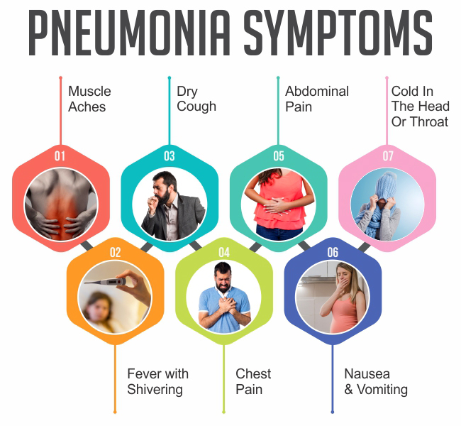

Slide 48
Treatment of pneumonia in the elderly
Bacteria, especially S. pneumoniae, remain the pathogens that most commonly cause pneumonia in the elderly, and CAPdue to H. influenzae, S. aureus, and enteric gram-negative bacilli occur more frequently in the elderly than in younger age groups.
Pneumonia that is associated with aspiration is usually associated with S. pneumoniae, H. influenzae, or S. aureus unless poor dentition is present, raising the possibility of pneumonia caused by anaerobic bacteria.
Additionally, the elderly are more likely to have colonization with gram-negative bacilli, particularly if they reside in long-term care facilities.
The presence of diseases that alter lung structure such as COPD or bronchiectasis also increase the likelihood of gram-negative rods as a cause of bacterial pneumonia.
Viral pneumonias, although comprising a smaller proportion of lower respiratory tract infections in the elderly, can have significant morbidity and mortality as well as predispose the elderly individual to subsequent serious bacterial pneumonia.

Slide 49
Causes of Antimicrobial (Drug) Resistance
There are several ways this happens:
natural (biological) causes - selective pressure, mutation, gene transfer
Societal Pressures
Inappropriate Use
Inadequate Diagnostics
Hospital Use
Agricultural Use

Slide 50
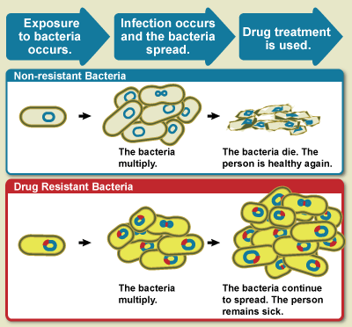
Notes:
Diagram showing the difference between non-resistant bacteria and drug resistant bacteria. Non-resistant bacteria multiply, and upon drug treatment, the bacteria die. Drug resistant bacteria multiply as well, but upon drug treatment, the bacteria continue to spread.

Slide 51
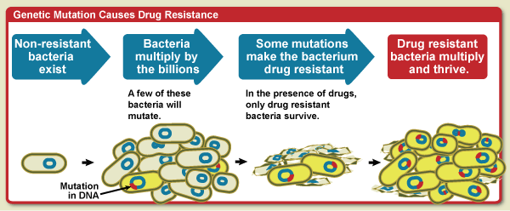
Notes:
Diagram showing that when bacteria mulitply some will mutate. Some of those mutations can make the bacteria resistance to drug treatment. In the presence of the drugs, only the resistant bacteria survive and then multiply and thrive.

Slide 52
Notes:
Diagram showing how gene transfer facilitates the spread of drug resistance. Bacteria multiply by the billions. Bacteria that have drug resistant DNA may transfer a copy of these genes to other bacteria. Non-resistant bacteria recieve the new DNA and become resistant to drugs. In the presence of drugs, only drug-resistant bacteria survive. The drug resistant bacteria multiply and thrive.

Slide 53
Interventions to prevent pneumonia in the elderly
Vaccination (pneumococcus, influenza virus)
Prophylaxis and early treatment of viral influenza outbreaks
Optimize nutritional status
Minimize risk of aspiration
Adequate therapy of chronic disease states
Avoid institutionalization (if possible)
Smoking cessation

Slide 54
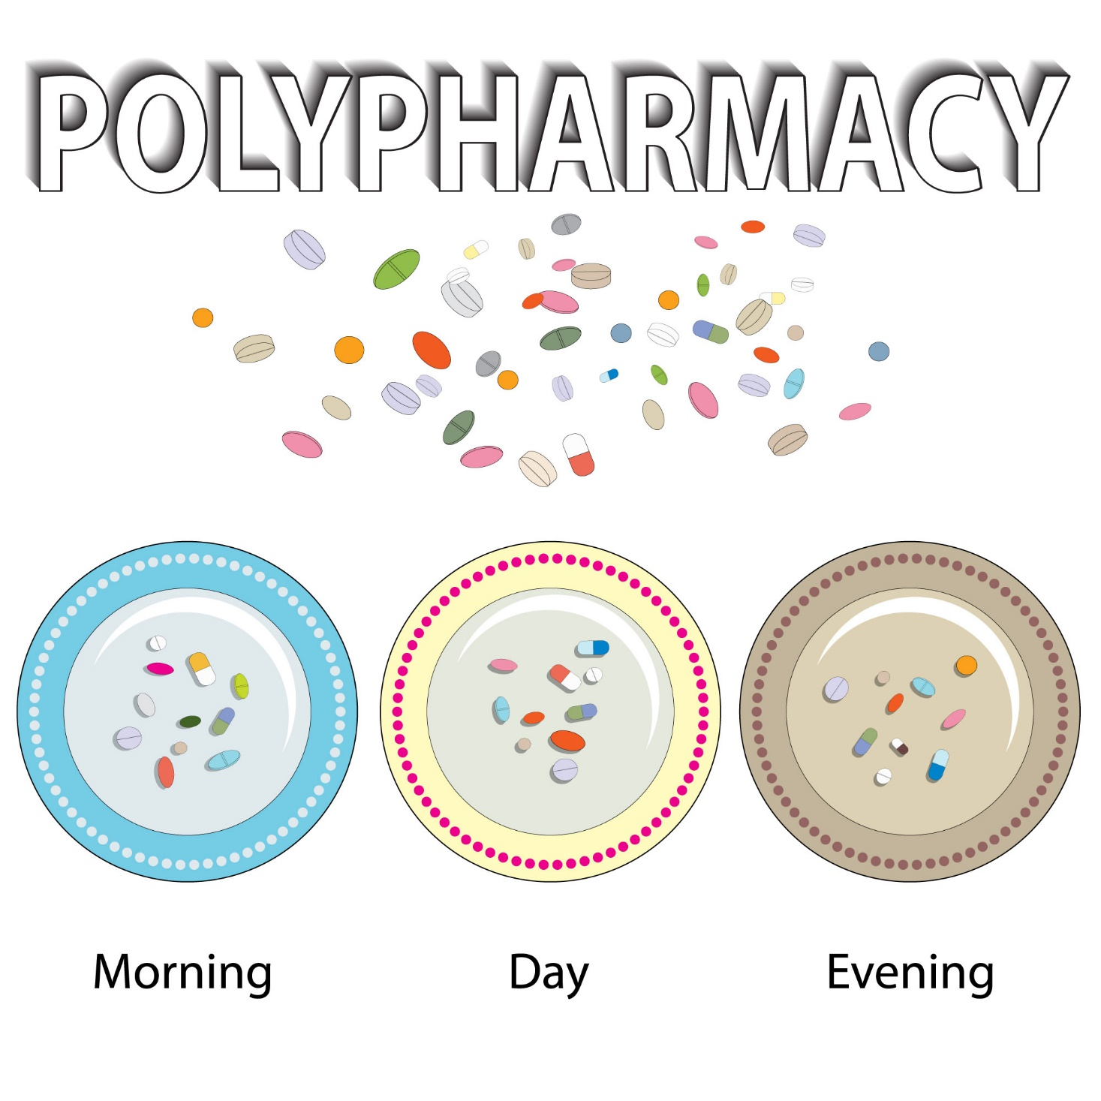

Slide 55
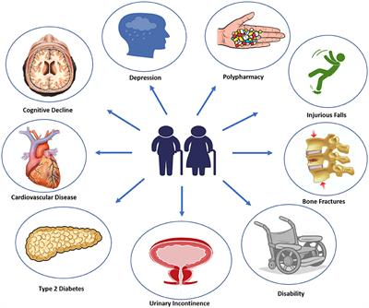

Slide 58
Potential geroprotectors
Geroprotectors are therapeutics that affect the root cause of aging and age-related diseases, and thus slow down the aging process.
These have a potential to improve age-associated disease such as COPD. Calorie restriction is the best researched intervention in aging in diverse species from yeast to primate. Most of geroprotectors might mimic calorie restriction.
Greater understanding of the molecular mechanisms of aging has revealed several novel targets for anti-aging drugs/geroprotectors although the information about the effects of those drugs in the respiratory system is still limited

Slide 59
Metformin
Metformin (N,N-dimethylbiguanide) is an anti-glycemic, biguanide class drug used in the treatment of diabetes mellitus and polycystic ovarian syndrome. Several studies have shown that metformin can slow down the rate of aging, and decrease glucose, insulin and IGF-1 level. Thus Metformin has been described as a geroprotector.
However, metformin failed to activate AMPK in lung tissue because lungs have a very low expression of OCT1, a receptor responsible for metformin uptake in cells. Therefore, metformin unlikely affects lung epithelial cells directly, but possibly affects other resident cells such as alveolar macrophages and immune cells. Although patients with diabetes mellitus are not at increased risk for the development of lung cancer, the use of metformin type anti-diabetes drugs considerably decreased the risk.
As diabetes mellitus and metabolic syndrome are common in patients with COPD, metformin might affect comorbidity of COPD and improve symptom systemically.

Slide 60
Melatonin
Melatonin, N-acetyl-5-methoxytryptamine, is a naturally occurring compound found in animals, plants, and microbes. The pineal indole hormone melatonin is involved in the circadian rhythms (the sleep-wake cycle) of several biological functions through activation of melatonin receptors. Besides its function, melatonin is also known to exert a powerful antioxidant activity. Melatonin is a direct scavenger of OH, O2−, and NO.
In bronchial asthma and COPD, melatonin level in serum was decreased during exacerbation with an increase in oxidative stress and a decrease in anti-oxidant enzymes. Melatonin has been tested for COPD.
Melatonin was also reported to suppress production of IL-883 and matrix metalloproteinase-9.

Slide 61
Resveratrol
Resveratrol (3,4′,5-trihydroxystilbene) the plant polyphenol, is found in various plants, including grapes, berries and peanuts. It is also present in wines, especially red wines.
Studies showed that resveratrol extended the life-span of yeast, worms, flies, fish and mice. Resveratrol appears to mediate these effects partly by activating SIRT1, a deacetylase enzyme.
Resveratrol is also reported to be a powerful anti-oxidant as well as a PI3K inhibitor. Recently, Dallaire and Marette demonstrated that resveratrol inhibited inducible nitric oxide synthase in skeletal muscle by AMPK activation rather than SIRT1 activation.
As we described above, AMPK activator also leads to SIRT1 activation. Thus resveratrol affects AMPK-SIRT1 axis and showed anti-aging effects. In addition, there are a lot of evidences of anti-inflammatory effects of resveratrol in lung cells.

Slide 62
PI3K inhibitors
In C. elegans, age-1 (human PI3K homolog) mutant showed longer life, suggesting that Pl3K inhibition extends life span. In fact, a pan PI3K inhibitor, LY294002 (2-(4-Morpholinyl)-8-phenyl-4H-1-benzopyran-4-one) at higher concentrations significantly resulted in a small, but significant, increase in life-span.
We previously demonstrated that PI3Kδ was upregulated in peripheral lung of COPD and it is involved in corticosteroid resistance. None of PI3Kδ inhibitors is available in clinic, but theophylline is known to exert functional PI3Kδ inhibition at lower dose. When low dose theophylline was used with steroid, it showed better efficacy in asthma and COPD than steroid alone.
Theophylline reversed defect of HDAC activity via PI3Kδ inhibition. As HDAC2 is known as anti-aging molecule, theophylline is a kind of anti-aging agent. Theophylline is also reported to inhibit NAD+ consumption by PARP-1 activation and may therefore restore SIRT1 activity reduced under oxidative stress.

Slide 63
mTOR inhibitor
Mammalian target of rapamycin (mTOR) is a serine/threonine kinase in the phosphoinositide 3-kinase (PI3K)-related kinase family. Therefore, inhibition of mTOR leads to geroprotection.
Rapamycin (Sirolimus) is an immunosuppressive agent used to prevent rejection in transplantation patients.
This inhibits TORC1 and this inhibition extended the life span of yeast, C. elegance, Drosophila and mice. Very interestingly, the effect of mTOR inhibition is sex dependent, and rapamycin showed more moderate increase in life span in male rather than female in flies and mice. However, rapamycin showed immunosuppressive action by an anti-proliferative effect on clonal expansion of activated lymphocytes. Long term trial of rapamycin has not been conducted in COPD.

Slide 64
SIRT activator
Sirtuins are anti-aging molecules and control oxidative stress resistance, DNA repair and inflammation as described above. In addition, SIRT1 negatively regulated MMP9 synthesis and SIRT1 knockdown by RNA interference enhanced MMP9 synthesis and activation.
In fact, SIRT1 mRNA and protein expression are reduced in peripheral lung and alveolar macrophages of patients with COPD. Even more importantly (therapeutically), SIRT1 overexpression inhibited MMP9 expression stimulated by LPS in U937 cells.
As described as previous page, Resveratrol is known as a sirtuin activator although the molecular mechanism is controversial.
In sub-chronic smoking mice, SIRT1 activity in lung was decreased but SRT2172 intra-nasal treatment reversed this reduction. Exercise tolerance was impaired and oxygen saturation, as well as SPO2 level, after exercise was lowered in the smoking mice, but SRT2172 treatment restored exercise tolerance and SPO2 level as we previously reported. Thus, SIRT1 activators are promising agents for the treatment of COPD in future.

Slide 65
Nrf2 activator
Currently available antioxidants, such as N-acetyl cysteine, are not very potent and may not sufficiently reduce oxidative stress in the lungs.
Although some new anti-oxidants such as glutathione and superoxide dismutase analogs have been developed, novel and more effective antioxidants are required. Nuclear factor erythroid 2-related factor 2 (Nrf2) is a cap’n’collar family member redox-sensitive transcription factor that induces endogenous anti-oxidant molecules. Therefore this is a potential target to increase anti-oxidant activity. As previously reported, Nrf2 function is impaired in COPD.
We found that HDAC2 reduction by cigarette smoke exposure caused hyperacetylation of Nrf2,63 resulting in defect of Nrf2 induction. There are a lot of candidates as Nrf2 activators. Sulforaphane, which is extracted from broccoli, is reported as a Nrf2 activator.100 Malhotra and colleagues recently demonstrated that treatment with sulforaphane stimulated Nrf2, resulting in denitrosylation of HDAC2 and restoration of steroid sensitivity in alveolar macrophages from patients with COPD.
Thus, sulforaphane, by activating Nrf2, is a novel therapy for reversing corticosteroid resistance in COPD and other corticosteroid-resistant inflammatory diseases.

Slide 66
Thank you

